Slide 1
ADULT EDUCATOR - CHALLENGES AND TRENDS The UK Simon Dawson

Slide 2
The Setting
The UK is a unitary parliamentary democracy and constitutional monarchy
A nation of states and not a nation state
England
Scotland
Wales
Northern Ireland
Each state is responsible for their own educational systems

Slide 3
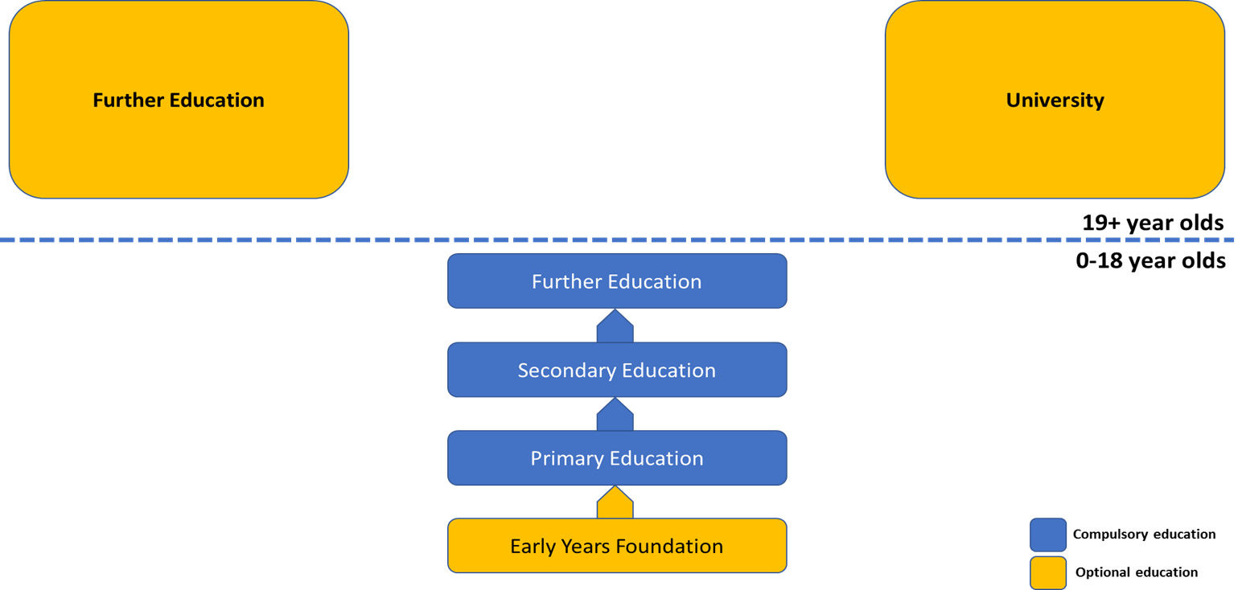
English Educational System

Slide 4
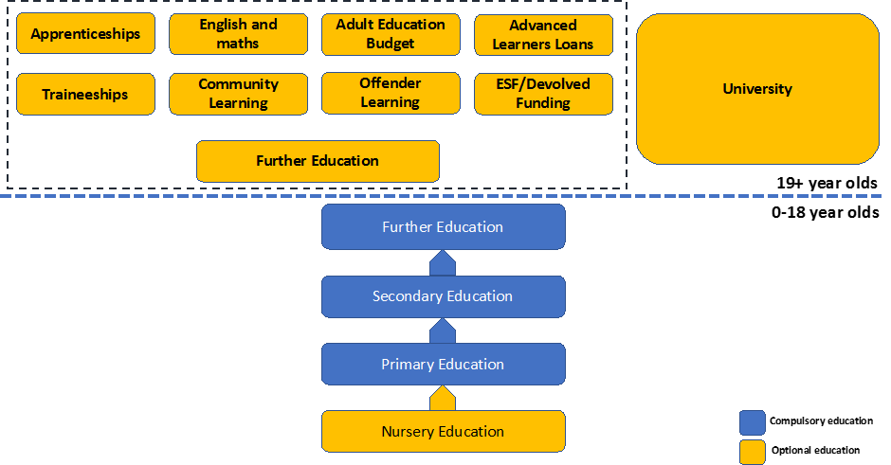
English Educational System

Slide 5
English Educational Devolution

Slide 6
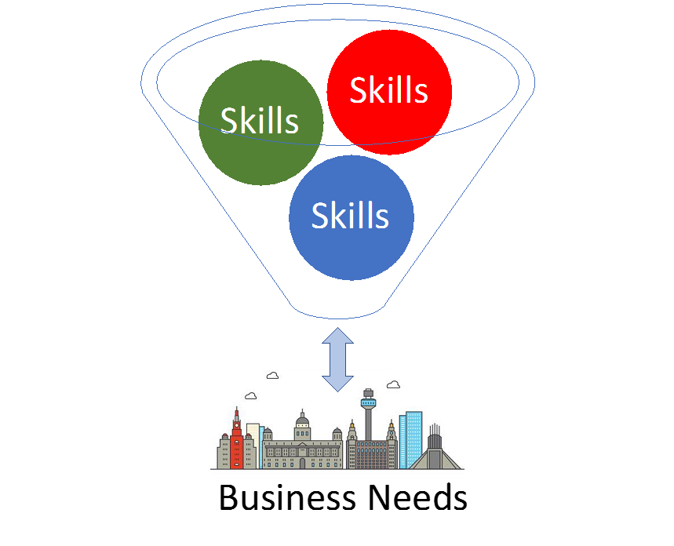
English Educational Strategy

Slide 7
English Educational Strategy
Great complexity of training offer
Great complexity of business needs

Slide 8
Educational & Vocational Counsellors
No national team of educational & vocational counsellors
Training packages are trainee-led

Slide 9
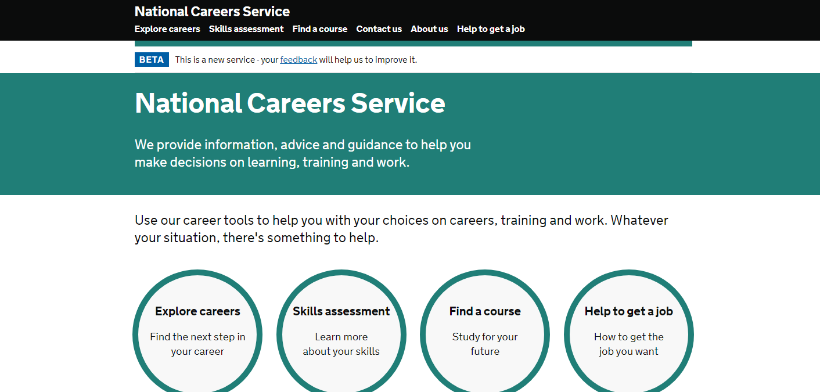
Information Systems

Slide 10
Information Systems
Accuracy ?
Timeliness ?

Slide 11
Skills Brokers
No national skill broker service
Locally funded, employer-led Skills Brokers
Level 4 Information, Advice & Guidance or Degree
Practical industry experience
Negotiation skills
Financial management skills
Understanding of Government policy and legislation
Lack of trainee-led Information, Advice & Guidance

Slide 12
Matrix Standard
Quality Standard
Leadership & Management
Resources
Service Delivery
Continuous Quality Improvement

